Slide 1


SRI RAMAKRISHNA ENGINEERING COLLEGE
[Educational Service : SNR Sons Charitable Trust]
[Autonomous Institution, Reaccredited by NAAC with ‘A+’ Grade]
[Approved by AICTE and Permanently Affiliated to Anna University, Chennai]
[ISO 9001:2015 Certified and all Eligible Programmes Accredited by NBA]
VATTAMALAIPALAYAM, N.G.G.O. COLONY POST, COIMBATORE – 641 022.
ARTIFICIAL INTELLIGENCE AND DATA SCIENCE
20AD272- MINI-PROJECT -I
Title: SYSTEM SURVEILLANCE USING KEYLOGGERS
PROJECT MENTOR:
MR. B. MOHANKUMAR (Sr .Gr)
DEPARTMENT OF INFORMATION TECHNOLOGY
TEAM MEMBERS:
2011001 AATHEESH P V
2011009 BARANIDHARAN
2011032 RAGUL K V

Slide 2
AGENDA
ABSTRACT
INTRODUCTION
LITERATURE REVIEW
PROBLEM DEFINITION
OBJECTIVES
BLOCK DIAGRAM
MODULE DESCRIPTION
SOFTWARE REQUIREMENTS
RESULT
CONCLUSION
FUTURE SCOPE
REFERENCES

Slide 3
ABSTRACT
Keylogger software can be used to retrieve statistics while working record is broken because of numerous reasons like loss of strength and many others.
Use of this application is that customers can recollect forgotten email or URL.
On this keylogger task, whenever the consumer sorts something via the keyboard, the keystrokes are captured and mailed to the mail identity of admin without the understanding of the person in the time set.

Slide 4
INTRODUCTION
Keyloggers are particularly effective in monitoring ongoing crimes that is a surveillance utility used to track the users which log keystrokes, makes use of log documents to retrieve records, capture a record of all typed keys.
The accrued records are saved on the machine as a hidden report or emailed to the Admin or the forensic analyst.

Slide 5
LITERATURE REVIEW
Title | Author | Year of Publication | Description
Keyloggers in Cybersecurity Education Christopher Wood https://citeseerx.ist.psu.edu/viewdoc/download?doi=10.1.1.600.5731&rep=rep1&type=pdf | Christopher A. Wood and Rajendra K. Raj | 2010 | This paper provides an overview of keylogger programs, discusses keylogger design, implementation, and usage, and presents effective approaches to detect and prevent keylogging attacks.
Keyloggers for windows using Python https://www.scribd.com/document/489823348/Keylogger-for-Windows-using-Python | Santripti Bhujel, Mrs. N. Priya | 2020 | This paper completely deals with keyloggers with python used in windows. This thesis tells how to monitor the keystrokes using python.

Slide 6
LITERATURE REVIEW
Title | Author | Year of Publication | Description
Developing Software Primarily Based Key logger and a technique to protect from Unknown Key loggers https://www.ijisme.org/wp-content/uploads/papers/v3i7/G0881063715.pdf | Sivarajeshwaran S Ramya G Priya G | 2019 | This paper completely deals with the software based keyloggers and keylogging . This paper tells how to prevent the keylogger virus from recording keystrokes.
A Layered Architecture For Detection Malicious Behaviours http://theory.stanford.edu/people/jcm/papers/raid_2008.pdf | Lorenzo Martignoni, Elizabeth Stinson, Matt Fredrikson, Somesh Jha | 2008 | This paper tells about malicious tools such as keyloggers, proxying, data leaking.

Slide 7
PROBLEM DEFINITION
Generally, when the system is used by the third party, user will misuse the system and cause damages, to avoid this kind of problem, keyloggers will be used to record keystrokes, screenshots and saving as a hidden file or sending mail to the admin.
This process uses short time to record the keystrokes and taking screenshots of the immediately changed pages.

Slide 8
OBJECTIVES
Records the keystrokes.
Recorded keystrokes will be send to the admin’s mail.
Recorded keystroke will be saved as a hidden file.
Takes screenshots of the immediately changed pages.
Each and every recorded file will be encrypted.

Slide 9
BLOCK DIAGRAM
KEYBOARD
KEYBOARD CONTROLLER
OPERATING SYSTEM
KEYLOGGER
COMPUTER KEYBOARD INTERFACE
08-06-2022
20AD272-MINI PROJECT

Slide 10
MODULE DESCRIPTION
MODULE 1 : KEYSTROKES RECORDING
MODULE 2 : MAIL SENDING AND SAVING FILE
MODULE 3 : SCREENSHOT SAVING
MODULE 4 :ENCRYPTION AND DECRYPTION

Slide 11
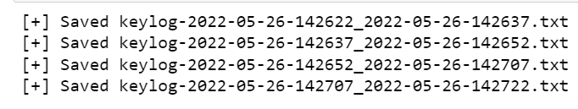
KEYSTROKES RECORDING
In this module, keyloggers will be recording the keystrokes used by third party
Using the module ‘keyboard’ keystrokes can be recorded. The module ‘keyboard is used to deal with the operations related to keyboard.
This module uses ‘Timer’ package from ‘threading’ module and ‘datetime’ package from ‘datetime’ module to record the keystrokes with date and time.

Slide 12
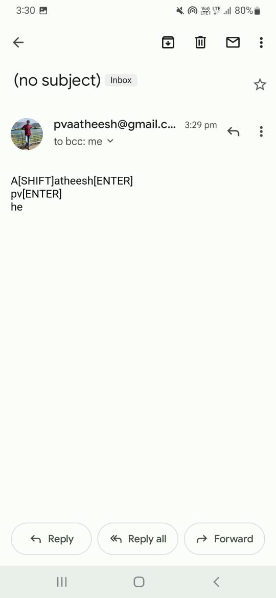
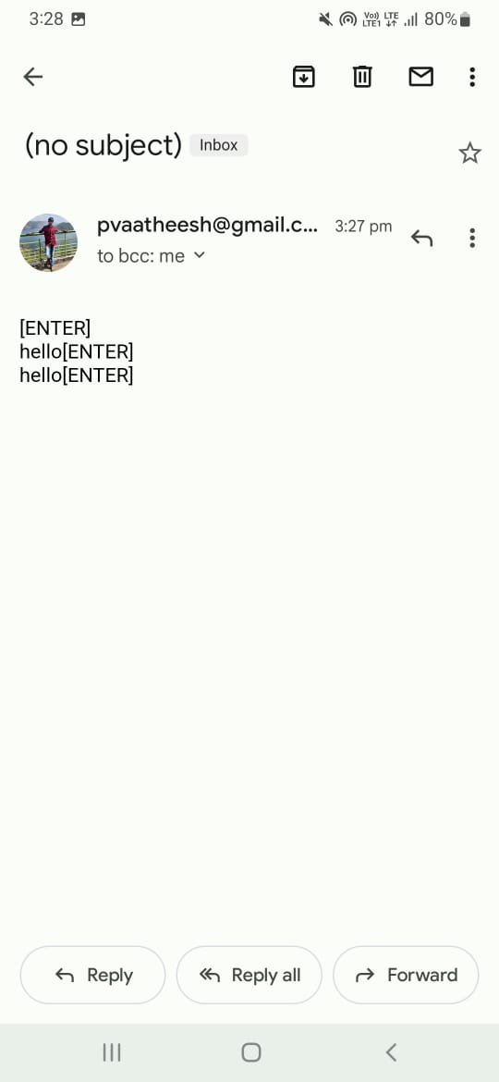
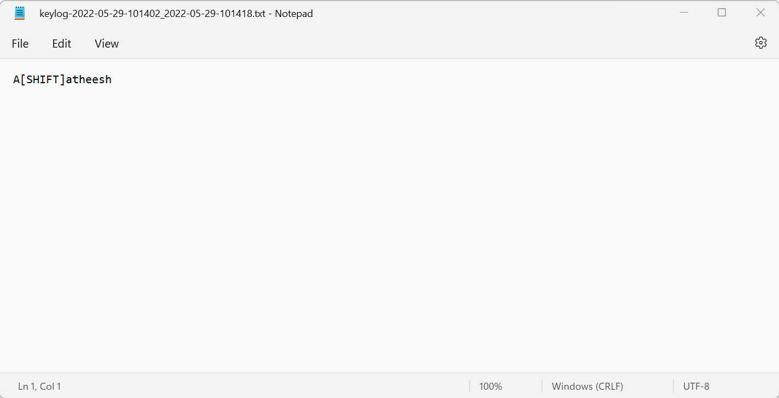
MAIL SENDING AND SAVING FILE
In this module, the recorded keystrokes will be sent to the admin through the mail.
This module uses ‘smtplib’ library to send the mail to the admin.
This module uses temporary password to send the mail.
Using the first module, the recorded keystrokes will be saved as an .txt file extension.

Slide 13
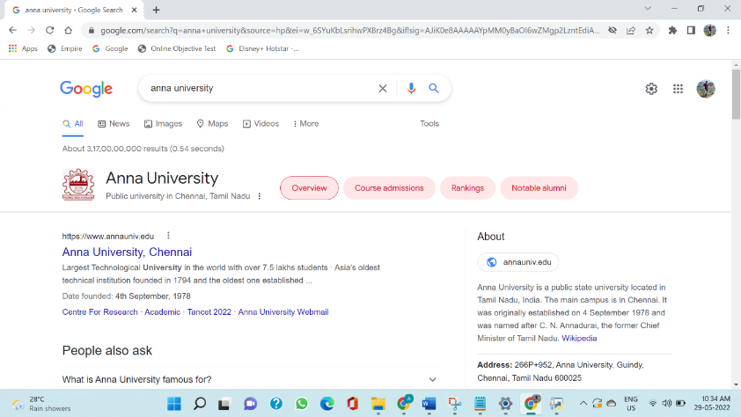
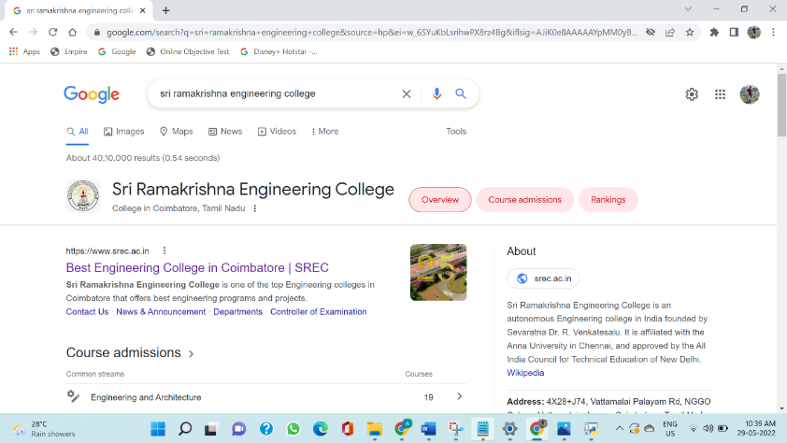
SCREENSHOT SAVING
In this module screenshots of immediately changed pages will be taken and saved with the present date and time.
This module uses ‘ImageGrab’ package from the module ‘pyscreenshot’ to take the screenshots

Slide 14
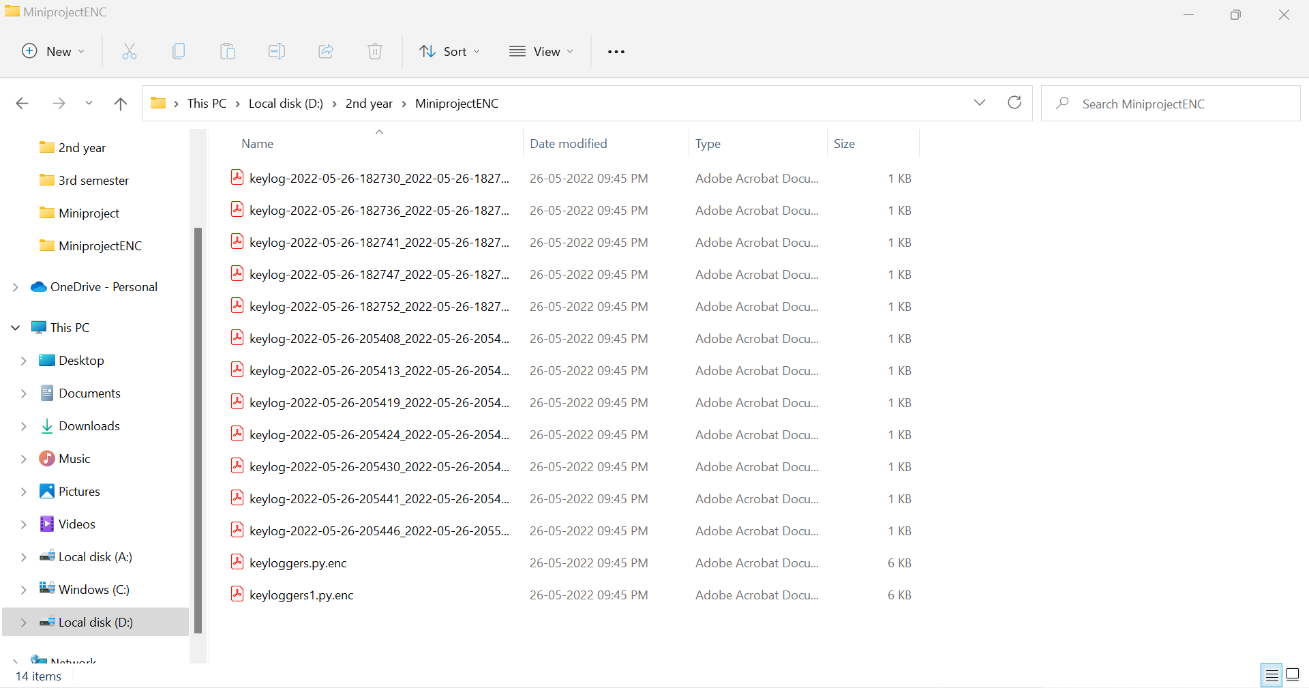
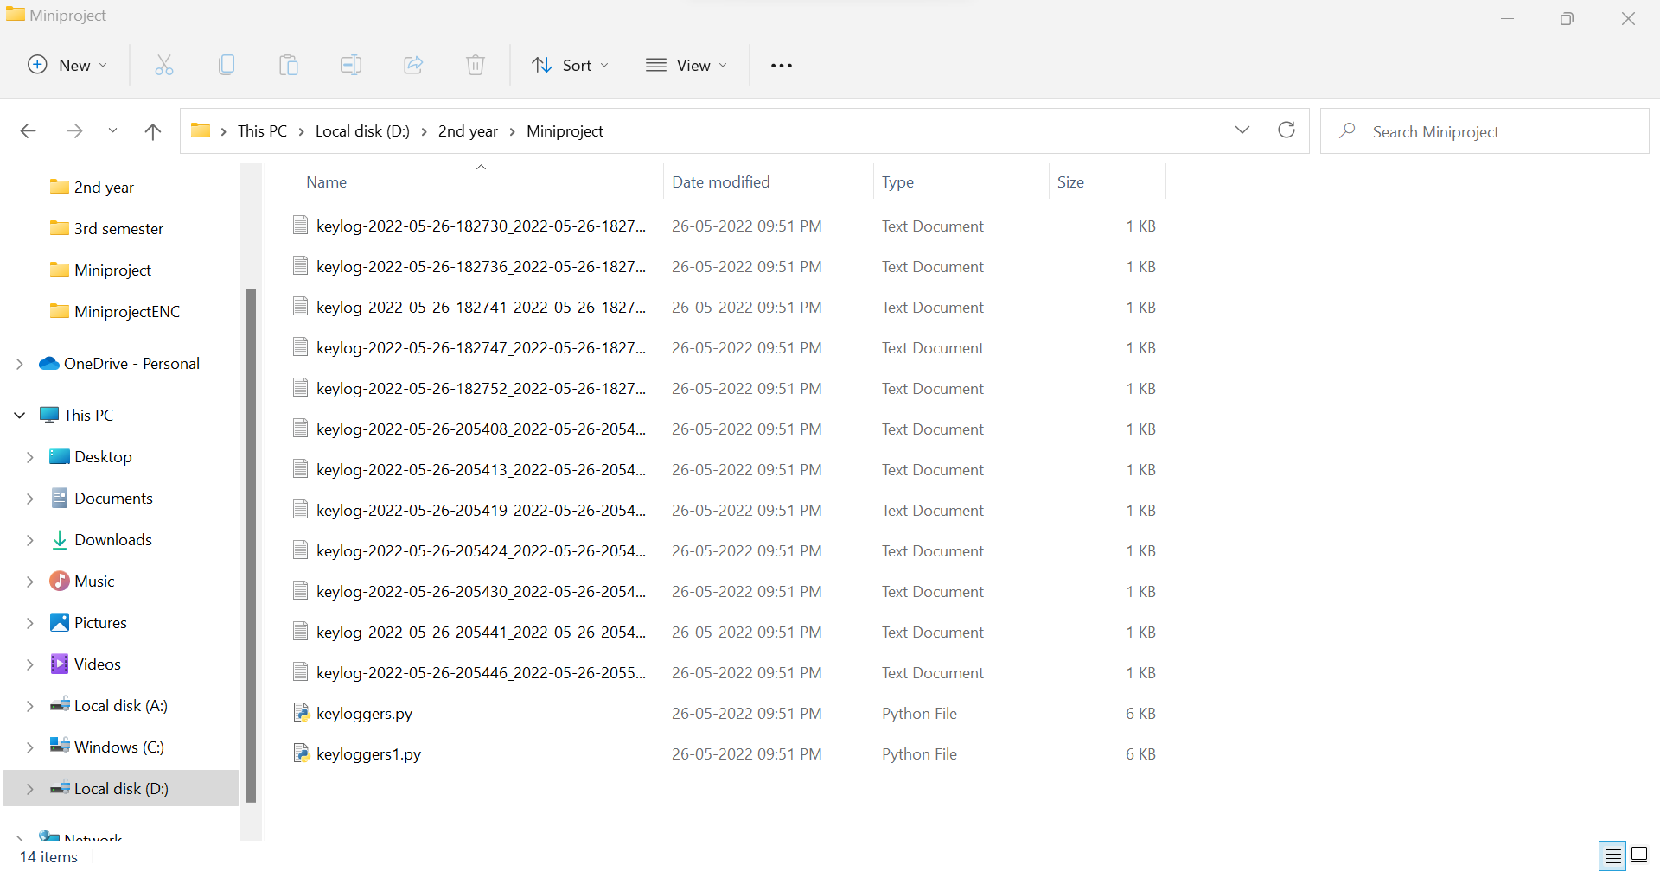
ENCRYPTION-DECRYPTION
In this module, the text files and screenshots will be encrypted.
This module uses ‘os’ library to get the path of the folder from the system.
This module uses ‘secret’ library to create the random elements to generate the password.
This module uses ‘shutil’ library to deal with the operations related to the file.
14

Slide 15
SOFTWARE REQUIREMENTS
PYTHON 3.8.0
JUPYTER NOTEBOOK

Slide 16
RESULTS
Keyloggers are implemented to record keystrokes performed by the third user. This project saves the recorded keystrokes as a hidden file or send to admin’s email ID.
This project takes the screenshots of the immediately changed pages according to the given schedule of time. Each and every text files, screenshot and related program files will be encrypted with the password.
User can either choose file method to save the keystrokes as text file or mail to send the recorded keystrokes to the admin’s email-ID.

Slide 17
CONCLUSION
Keyloggers can be used in personal computer for monitoring the system, when the third person uses.
This keyloggers records keystrokes and send mail to the admin.
It can also save the keystrokes as a hidden text file.
This keyloggers takes screenshots for every one minute.

Slide 18
FUTURE SCOPE
In future, each and every person can check the activities of the third person when they misuse the system. Parents can check the activities of the children while performing in the system.
In future keyloggers will be used by each and every company to check the activities of the employees performed in the system during work hours.

Slide 19
REFERENCES
Anitha, S.S.A. 2011 “Detecting keylogger based on visitor’s analysis with periodic behavior”, PSG College of Technology, Coimbatore, India.
Le, C. Y. D., Smart T, and Wang H., 2008, “Detecting Kernel Level Keyloggers Through Dynamic Taint Analysis,” University of William & Mary.
Martignoni E. S. L., Fredrikson M, Jha S, and Mitchell J. C., 2008 “A layered Structure for detecting malicious behaviors”. Heidelberg.
Rajendra, C.A.. “Keylogger in Cybersecurity education”. Rechester Institute of technology, Rechester, the big apple, United States of America
Sagiroglu, S. and Canbek, G., 2009, “Keyloggers” IEEE Technology and Society Mag, Vol. 28, No. 3, pp. 10-17.

